Slide 1



LSPU STUDENT AI-DE
CHATBOT

Slide 2




members
ANGELES, KHATRINA
CORONADO, NIXON
SOFER, ERL TEODEMAR

Slide 3

introduction

Slide 4

introduction
The LSPU Student AI-de is a chatbot that aims to be the FAQ version of the university student handbook, able to answer questions about university policies, available college courses, a guide to enrollment, and navigation of the university system.

Slide 5

introduction
DOMAIN
The scope of the chatbot includes all students enrolled or to be enrolled, and staff at the Laguna State Polytechnic University.
REASONING
We chose an instruction-based method as required by the instructor for more dynamic responses. We thought it was appropriate with a dataset as large as the student handbook because the machine learning model can generate responses based from the patterns in the training data.

Slide 6
introduction
MACHINE LEARNING MODEL
Our chatbot utilizes the transformers-base model T5-base (Text-to-Text Transfer Transformer) for the natural language processing and the response generation.
T5 is not limited to a specific task, as it can handle data preparation, tokenization, training, response generation, and evaluation metrics, which is ideal for our chatbot,

Slide 7
data preparation

Slide 8
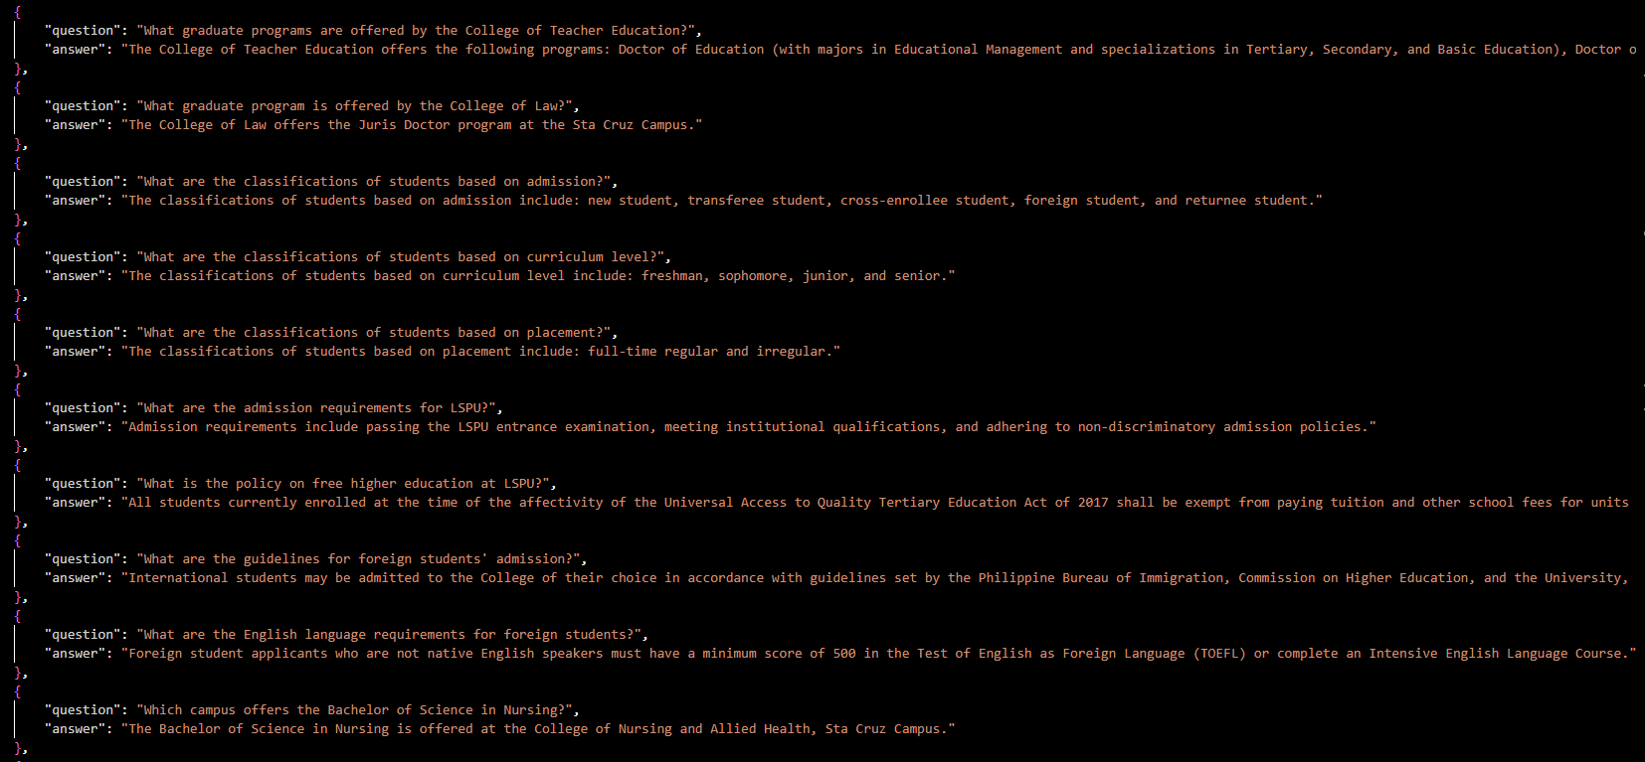
data preparation
DATASET SAMPLE

Slide 9

data preparation
DATASET DESCRIPTION
Using a question-and-answer format allows for straightforward mapping during training. The model learns to associate specific questions with their corresponding answers, making it easier to evaluate its performance based on how accurately it predicts answers for given questions.
Asking questions clearly helps the model generate more coherent and contextually appropriate responses, making it a more effective conversational tool.

Slide 10
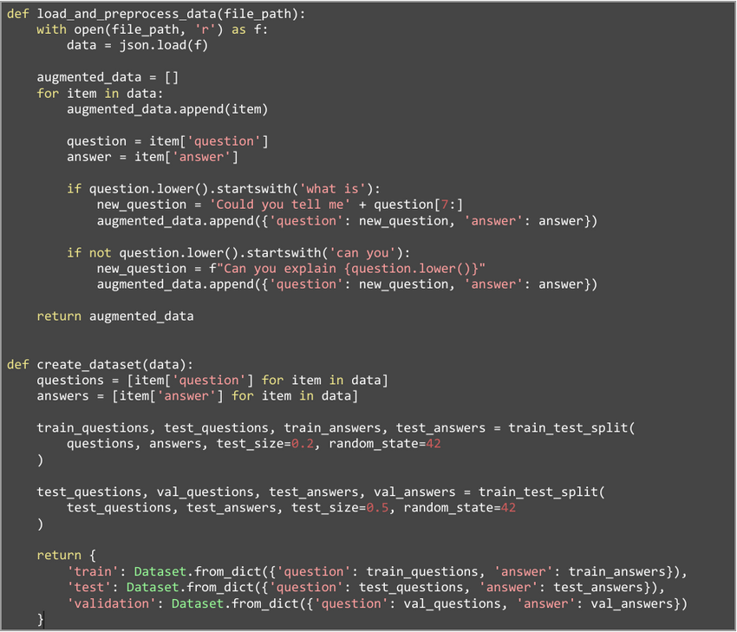
data preparation
PREPROCESSING STEPS
Load Data: The load_and_preprocess_data function opens and reads a JSON file containing question-answer pairs.
Iterate Through Data: For each item in the loaded data
Append the original question-answer pair to augmented_data.
Extract the question and answer from the current item.
Return Augmented Data: The function returns the list of augmented question-answer pairs.
Create Dataset: The create_dataset function takes the augmented data as input. Extracts questions and answers into separate lists.
Splits the data into training, validation, and test sets using train_test_split from scikit-learn, ensuring that 80% of the data is for training and 20% is split evenly for validation and testing.
Return Structured Datasets: The function returns a dictionary containing three datasets (train, validation, test) formatted for use in model training.

Slide 11
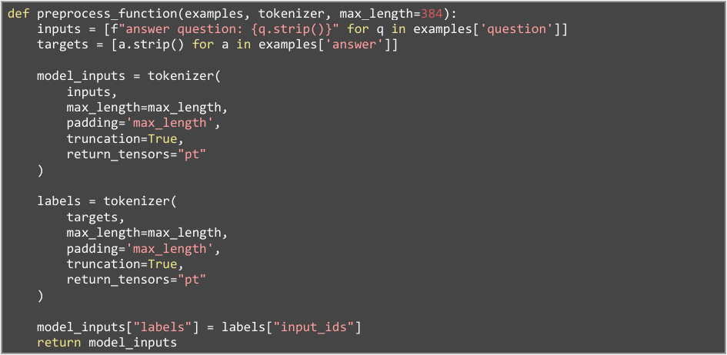
data preparation
Tokenization: The preprocess_function tokenizes the questions and answers using the T5 tokenizer. It converts questions into a format suitable for the T5 model by adding "answer question:" as a prefix.
Numerical Conversion: The tokenizer converts text into numerical IDs that the model can understand, pads sequences to a fixed length, and truncates longer sequences.
Input and Label Preparation: Finally, the function prepares the inputs and labels for the model by associating each input question with its corresponding target answer. This involves adding the labels (target answers) to the model inputs, ensuring that both inputs and outputs are correctly formatted for training.

Slide 12
model implementation

Slide 13

model implementation
REASONING TECHNIQUE
The reasoning technique is primarily instruction-based reasoning through the application of T5-base (Text-to-Text Transfer Transformer) model. This approach involves treating all natural language processing tasks as text-to-text problems, which means it can create responses based on what you input.
The use of T5-base as opposed to T5-small (aside from T5-large which Google Colab could not handle) is it has a larger number of parameters, which allows it to capture more complex patterns and nuances in the data. This extra capacity generally results in better understanding and generating responses, especially for tasks that need contextual awareness and intricate language processing.

Slide 14
model implementation
The core of the chatbot lies in the Chatbot class, which handles:
Model Initialization: Loading the pre-trained T5 model and tokenizer.
Question Preprocessing: Cleaning and formatting the user's question.
Response Generation: Encoding the question, generating responses using the T5 model, and evaluating confidence scores.

Slide 15
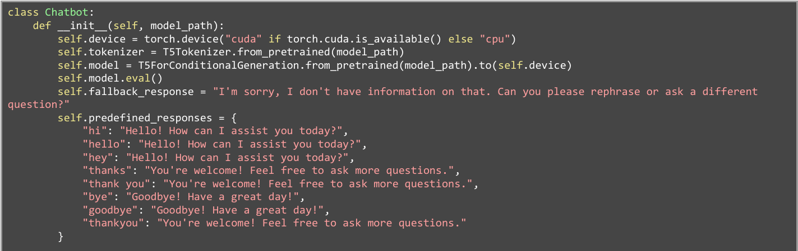
model implementation
Model Initialization: The Chatbot class initializes the chatbot by loading the trained model and tokenizer. It sets the device for computation (GPU if available, else CPU) and sets the model to evaluation mode. It defines a fallback response for when the model's confidence is low and includes predefined responses for common greetings.

Slide 16
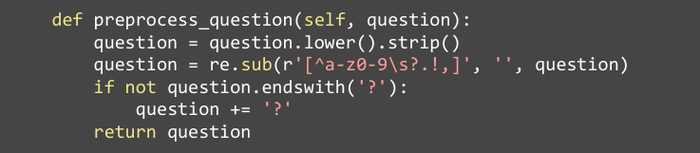
model implementation
Question Preprocessing: This function converts the input question to lowercase, removes unwanted characters using regular expressions, and ensures it ends with a question mark. This preprocessing helps standardize user input for better model understanding.

Slide 17
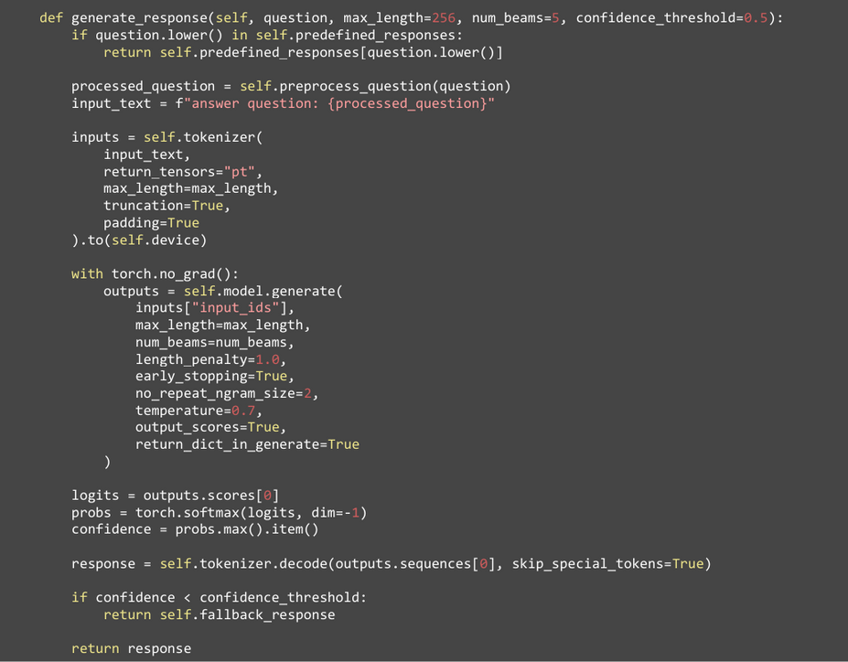
model implementation
Response Generation: This function generates a response based on the user's question. It first checks for predefined responses. If not found, it preprocesses the question, encodes it using the tokenizer, and generates a response using the model. The confidence score is calculated, and if it's below the threshold, the fallback response is returned.

Slide 18
training the model

Slide 19
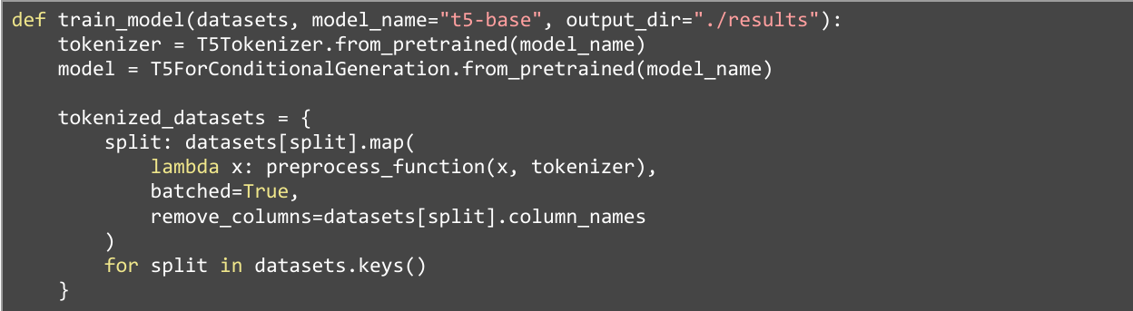
training the model
The train_model function loads the pre-trained T5 tokenizer and model. It then preprocesses the datasets using the defined preprocess_function and tokenizes them.

Slide 20
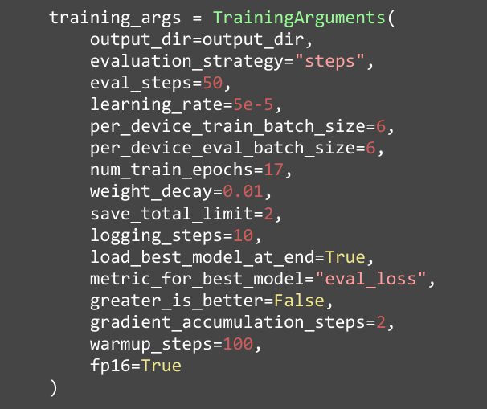
training the model
The TrainingArguments class sets up the training parameters, such as the output directory, learning rate, batch size, and number of epochs.
The learning rate is like a speed limit for how fast the model learns. It decides how much to change the model after each mistake. We set it at 5e-5 because it’s balanced in terms of speed and accuracy. We initially used 1e-5, but it was too slow, and the results were inaccurate.
The batch size is how many examples the model looks at before updating its settings. A batch size of 6 for the training and evaluation batch was also the limit we could do in Google Colab.
An epoch is one complete run through the entire training dataset. In each epoch, the model learns from every question and answer, helping it improve. 17 epochs was around the limit we could do in Google Colab.

Slide 21
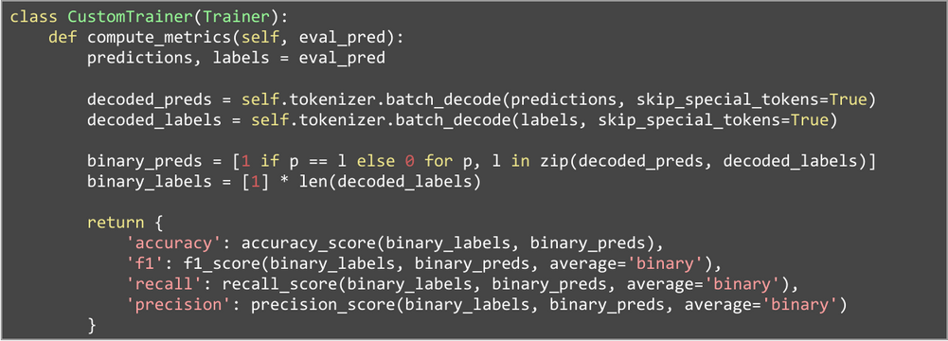
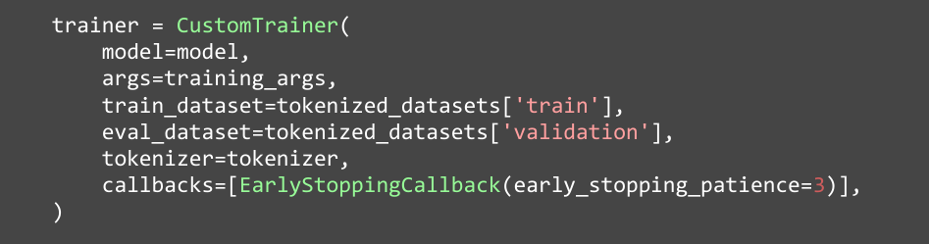
training the model
The custom trainer is initialized with the model, training arguments, datasets, and tokenizer.
This trainer is configured with the model, training arguments, tokenized datasets for training and evaluation, and an early stopping callback to prevent overfitting.

Slide 22

training the model
The trainer's train method is called to start the training process. he function returns the trained model, tokenizer, and trainer instance for further use or evaluation.

Slide 23
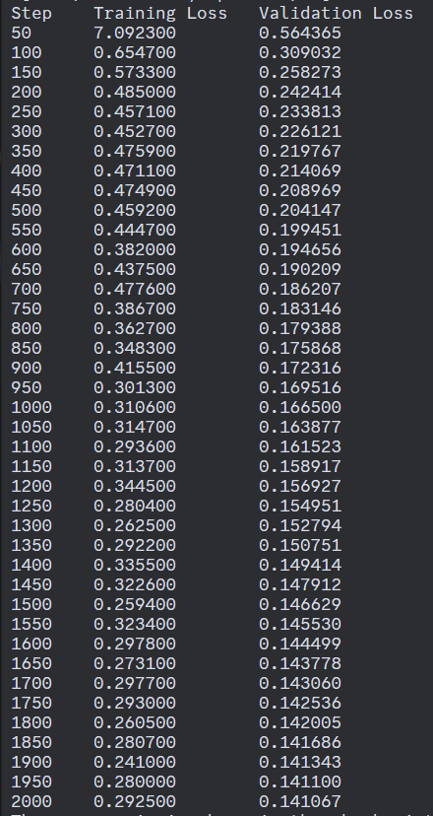
training the model
The training loss measures the model's fit to the training data. If the value is decreasing, then the model is learning effectively. As we can see here in the training output, it starts at 7.092300 at Step 50, but continually drops down more or less to 0.29500 at Step 2000.
The validation loss reflects how well the model performs on new unseen data. It’s also under the logic of when it decreases, it’s generalizing, not overfitting. We can also see that it performed effectively as it started at a value of 0.56465 and ended at around 141067.

Slide 24
testing and evaluation

Slide 25
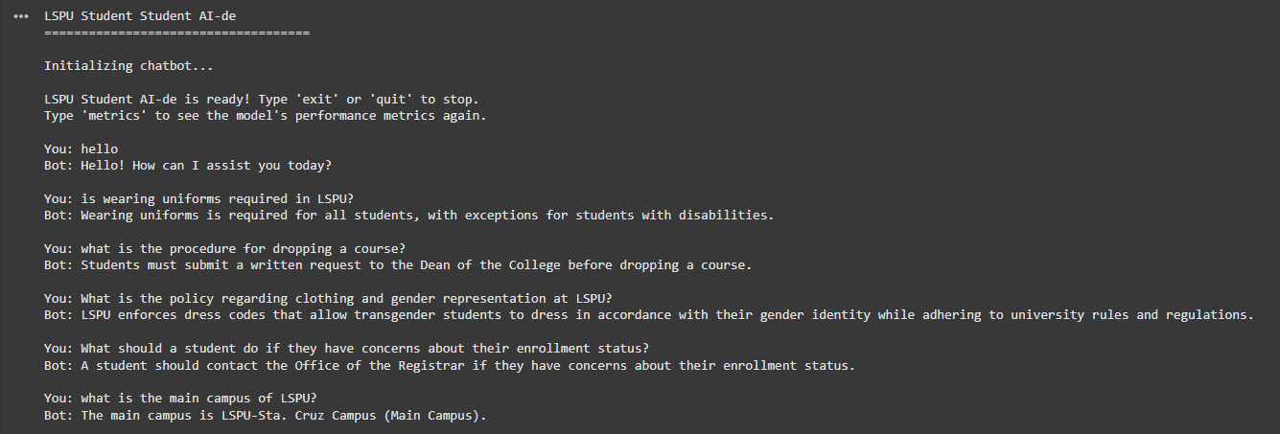
testing and evaluation
CHATBOT EXECUTION

Slide 26
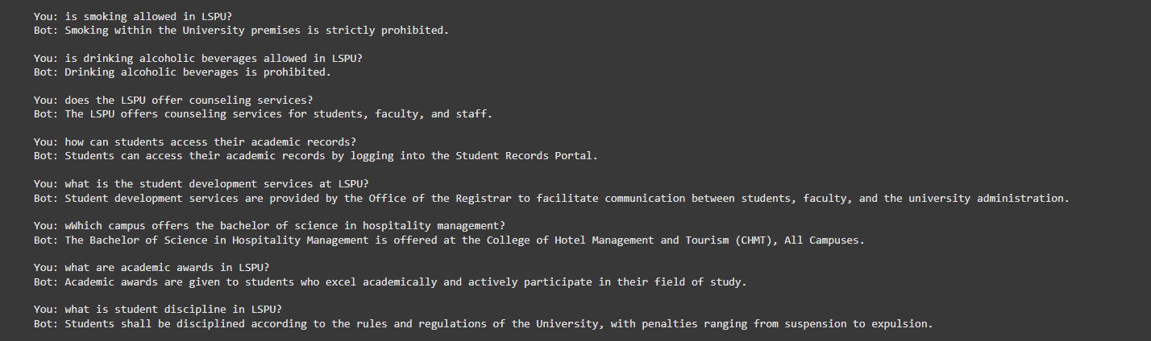
testing and evaluation
CHATBOT EXECUTION

Slide 27
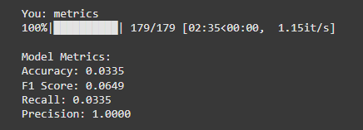
testing and evaluation
EVALUATION
As you can see, the model performed not as well as we expected it to be.
Accuracy: Only 3.35% of the predictions were correct which the model is struggling to provide the correct output consistently.
Recall: The model identifies only 3.35% of the true positives, meaning it’s missing a significant portion of correct answers.
Precision: Precision is perfect, meaning every prediction the model made as "correct" was right. Though this is the reason why you can’t just rely on one performance metric.
F1 Score: This combines precision and recall, and the low value is a clear imbalance between them. A perfect precision but very low recall drags the F1 score down.

Slide 28
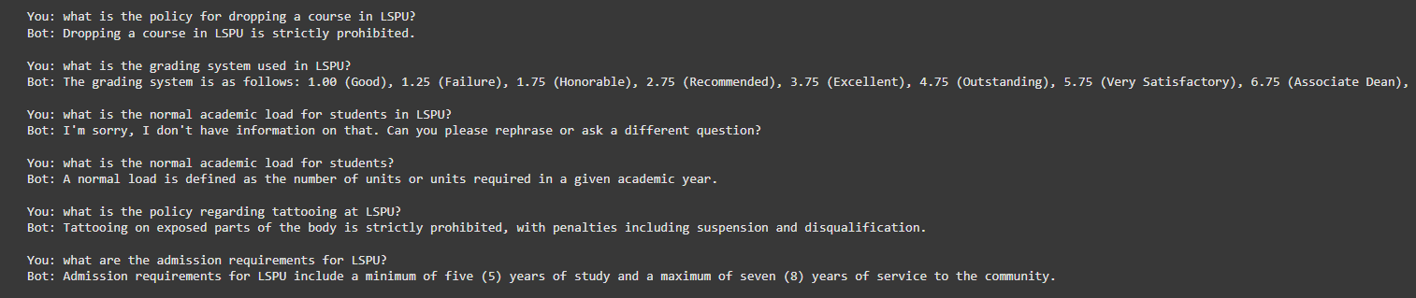
testing and evaluation
EVALUATION
The poor performance can actually be seen during testing, as it would give out nonsensical and funny answers.
On the bright side, it manages to give coherent answers and not gibberish.

Slide 29
challenges

Slide 30

challenges
Google Colab’s GPU and Memory Limit
This was by far the biggest hurdle. Google Colab’s has only around 4 hours worth of available memory and GPU training available for each user. Adjusting each parameter in the model training (making the epochs larger for more accuracy, increasing batch sizes, etc.) meant that we were consuming a lot of resources, and we were always getting cut off by Google.
This resulted in the poor performance of the model.
We could not possibly train the chatbot anymore than we did.

Slide 31
challenges
Dataset
The LSPU Student Handbook is 198 pages. Condensing this PDF was among our first challenges as it was dense. We found a way to convert it to a hierarchical format, but that wasn’t appropriate for the T5 model, so we had to convert around 75% of the data into a question and answer format.

Slide 32
conclusion

Slide 33

conclusion
The LSPU Student AI-de was a success in some ways, but falls short in others. It’s a fully functional instruction-based chatbot that can answer some questions about LSPU’s policies in that it relies more in the patterns of the dataset and generates its own responses, but because of limitations such as Google Colab’s finite amount of GPU and memory, it’s still is in its early stages.
As for suggestions for potential improvements, the dataset could be cleaner, much more detailed, to make a good reference for the model. Also, using more resources (GPU and memory) would be a great help in improving the chatbot as it can be trained with adjustments in its parameters. A user interface would also improve the usage of the chatbot.

Slide 34
thank you!

